Slide 1
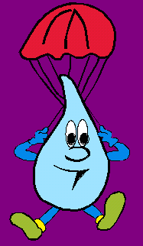
THE WATER CYCLE

Slide 2
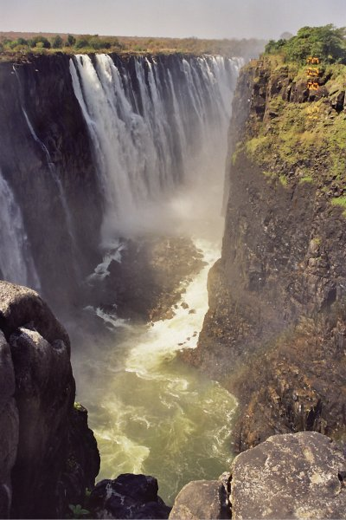
What do you know about water?
Why is The Earth called “The blue planet”?
What happens when water is at 100ºC?
When does it rain/ snow?
Where does the water of the rivers go?
What can you do with water?
Do you waste water?

Slide 3
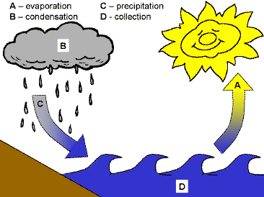
PROCESS
The earth has a limited
amount of water.
That water keeps
going around
and around in
what we call the
"Water Cycle".

Slide 4
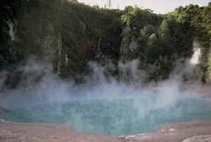
EVAPORATION
When the heats up
in rivers or lakes or the ocean and turns it into .
sun
water
steam

Slide 5
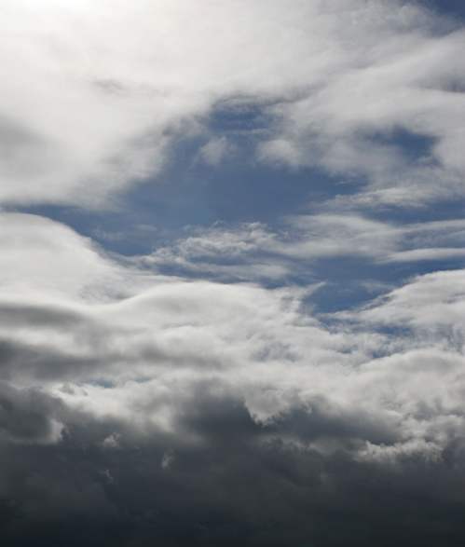
CONDENSATION
gets cold and changes back into liquid, forming .
Steam
clouds.

Slide 6
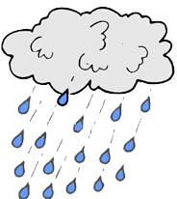
PRECIPITATION
The get heavy and falls back to the .
clouds
water
earth

Slide 7
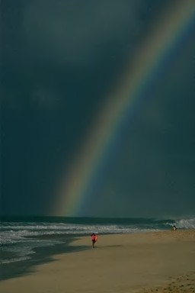
COLLECTION
When falls back in the , lakes or it may end up on land where the starts.
water
oceans
rivers
cycle

Slide 8
HOW DO YOU USE WATER?
Water Don'ts
Don't flush gum wrappers or tissues down the toilet. It's not a waste basket!
Don't let the water run when you brush your teeth or wash dishes.
Don't let the rest of your family waste water.

Slide 9
Water Do's
Do put a plastic bottle of water in your toilet tank.
Do keep a cold jug of water in the fridge for when you're thirsty.
Do take shorter showers or use less water in the bath tub.
Do wash your hands when your parents ask you to!

Slide 10
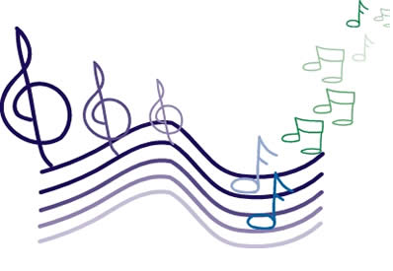
Sing the water cycle song!
WATER CYCLE SONG
Sang to the tune She’ll be coming around the mountain.
Water travels in a cycle, yes it does,
(use pointer finder to make a big circle)
Water travels in a cycle, yes it does,
(repeat finger cycle)
It goes up as evaporation
(move hands up to the sky)
Forms clouds as condensation
(make a cloud overhead with arms)
Then comes down as precipitation, yes it does!
(sprinkle with fingers while bringing arms down in front of you)

